Slide 1
Future of Higher Ed
PSC PD May 12, 2021

Slide 2
What we did this year at PSC
Some distance education (AKA DE, “online”)
Some face-to-face only (AKA F2F)
Mostly “choice” courses with F2F and Zoom simultaneously
Assuming Covid-19 is under control in September 2021
Some DE
Some “choice” by instructor choice
Mostly F2F only

Slide 3
We did very well this year
What everyone else did
What PSC did
Notes:
Students wanted face-to-face learning, and PSC mostly provided that

Slide 4
What we learned this year
Under tremendous pressure our faculty innovated and persevered
Let’s all hang on to some of that
Example: use Canvas to increase the predictability and flexibility of our classes. Use Zoom to connect with guest speakers
Notes:
Cathy Dove used to use a business phrase, that it is easier to make change when stuck on a “burning deck.”

Slide 5
Higher Education nationally faces a very strong headwind
Demographics are against us
Politically, Higher Education is unpopular
Families are questioning the “value proposition” of higher education
National number of HS grads

Slide 6
Students of the future
Demographics show us that the “student of the future” in the US is Hispanic, and likely female
Notes:
Our market is rural white males. The future of the US, and US higher education, is not

Slide 7
PSC has significant strengths
We stayed open through Covid
We are recognized as a safe place; and perhaps there is a turning against living in cities and migration to rural areas
Good enrollment in our MS-NRC
EAB identified good news this year for enrollment:
High “yield”
Stronger academic score
Notes:
Most schools “yield” under 8% of their admissions into deposits. We are over 20%
EAB ranks applicants on their academic strength from 1-5. We are getting more 4s and 5s thanks to the blanket scholarship

Slide 8
What does PSC provide?
Safe rural setting, with great outdoors experiences
Practical disciplines taught in a hands-on way
Faculty who pay a lot of attention and help students succeed
Commitment to the environment
Strong path to a job
Clubs, fun, etc.
Very strong Academic Support programs
Notes:
Question—so how would we get better? I think this is a really hard question!

Slide 9
What do students want?
College students generally want one (or more) of these things:
A learning experience
Job prep/certification
The “College Experience”
I believe that the conventional wisdom is that our students are in box 2, while in fact most are in box 3
Notes:
PSC’s actual strength is in helping students get a first job. Most of our students are probably not most focused on that, or more would show up for the Job Faire.
EAB research shows that due to Covid-19, current students are significantly less focused on careers than they were, and now care about the experience

Slide 10
Residential Learning
We provide a lot beyond the “college experience,” but likely that experience is what brings and keeps students here
Campus “traditions”
Learning communities
Comfortable “hang out” spaces indoors and out
Gazebo Lighting Picture?

Slide 11
Future builds on the past
My parents went to University College at the University of Toronto in the late 40s/early 50s
For some this would count as a golden age
Right place, right time, wrong people

Slide 12
The future of higher education
The past
The future
My parents attended UofT
A single set degree path
Four years in one place, or no degree at all and “failing”
“Quality” of degree determined by exams at the end of four years
Students were a small cultural elite
Modular degrees (Erasmus as a model)
Students moving around among colleges and stopping out
Hybrid learning
Internships/study-abroad/and other “experiences”
Student body is more representative of society but less well prepared

Slide 13
Path forward for PSC
Remain a “highly residential” college in spirit and practice
Offer more DE classes for flexibility and access reasons
Add some “choice” classes (F2F + Zoom) to help out students and faculty
Double down on internships/study away…this may require some changes to campus culture
Modularity: partnerships NCCC→ PSC, PSC → Clarkson, National Student Exchange, LCMC and Acadium

Slide 14
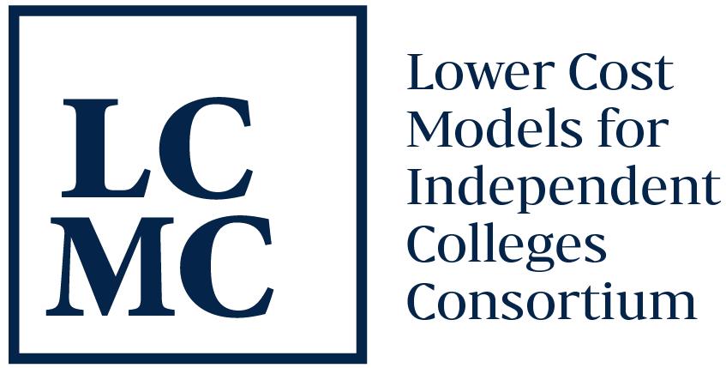
Partnerships
ASU course sharing
Acadeum (CIC) course sharing
LCMC/Rize curriculum/program sharing
NCCC
Others?

Slide 15
Certificates
Catie and I are exploring partnerships to support mini certificates to help career advancement
If this works we will need (paid) faculty help

Slide 16
Evolving models of learning
 | Location | Time | NYSED
Face to Face | Fixed | Fixed | No special approval
Distance Ed | Variable | Variable | Needs DE approval
hybrid | Fixed + Variable | Fixed | Counts as F2F
“choice” | Variable | Fixed | No one knows
Notes:
Which of these is best? We know hybrid has excellent outcomes
Choice model, like DE, requires a trade off which makes them better for some students

Slide 17
Our teaching method going forward
Which of these (F2F, DE, Hybrid, Choice) is best?
For students who need convenience, F2F is not possible, so they go somewhere else (Phoenix, SNHU, SUNY online)
We need to remain open to Zoom or F2F+Zoom “choice” teaching.
Notes:
Clay Christensen—”disruptive innovation”. Good companies fail because customers prefer a more convenient but inferior product, which rapidly gets better

Slide 18
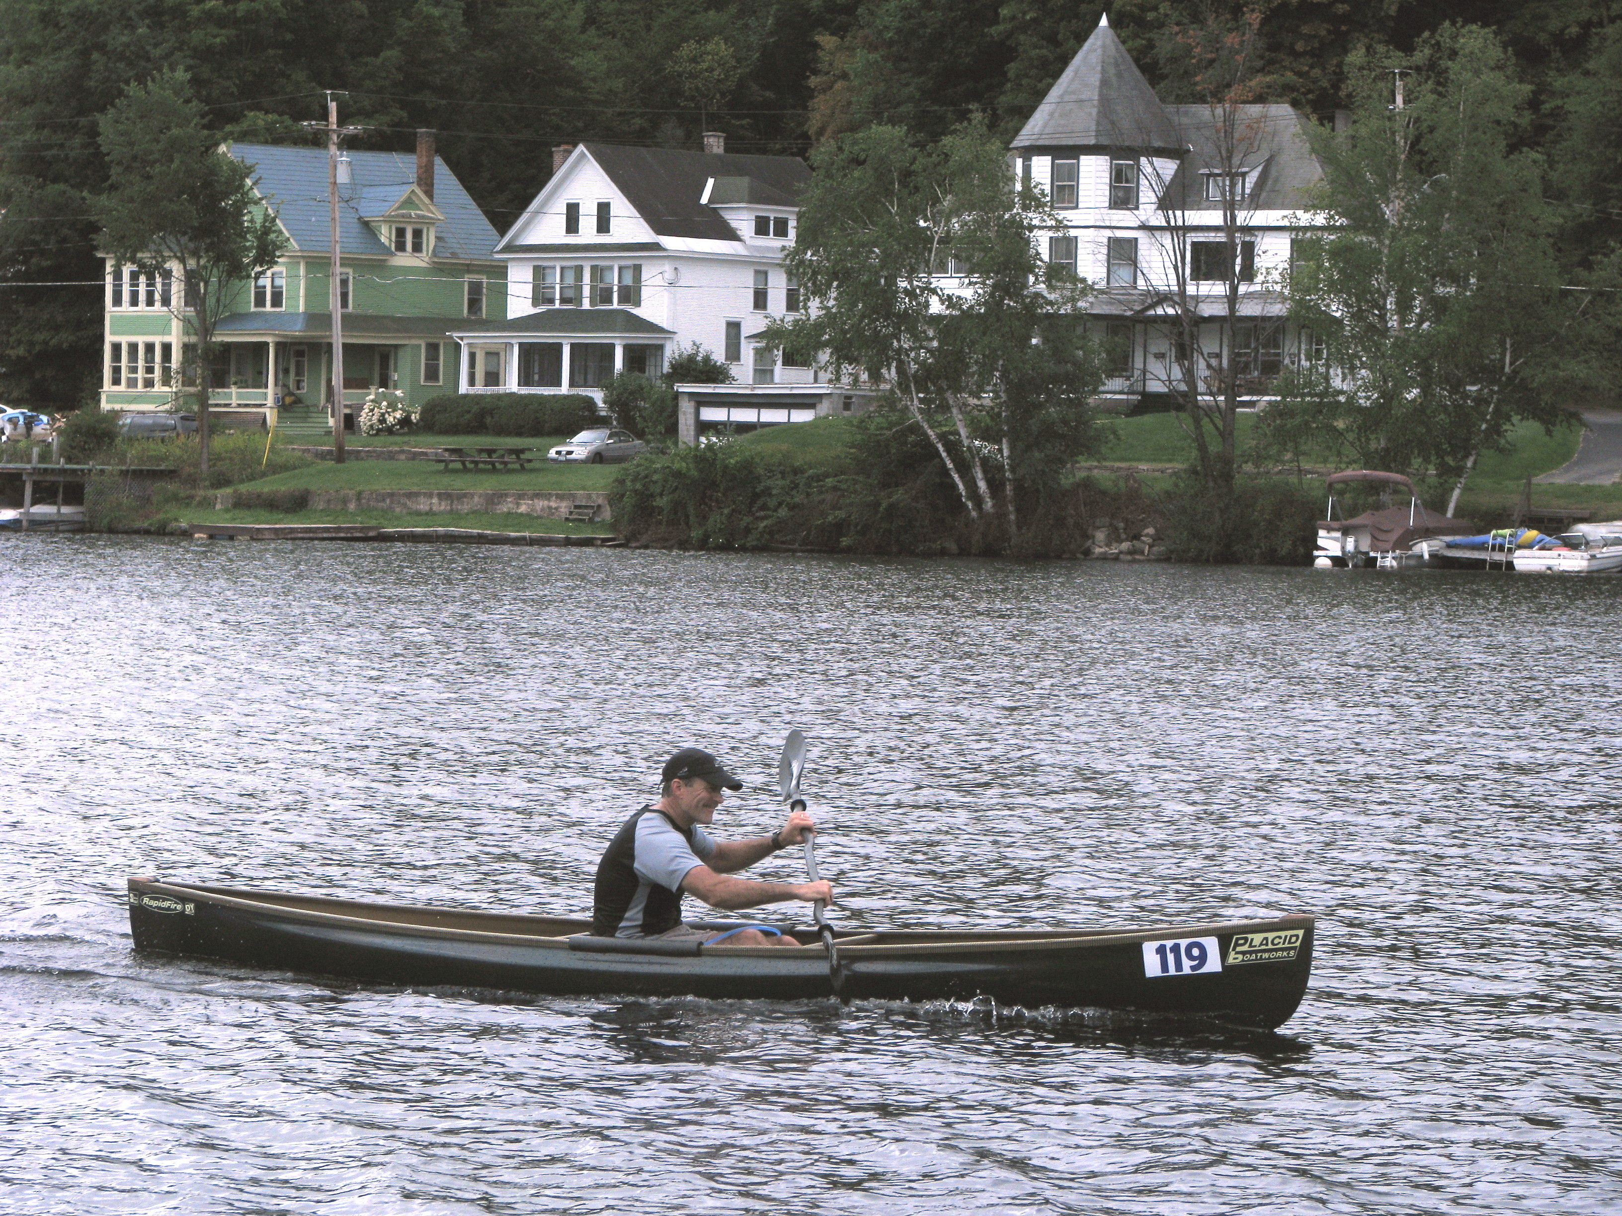
This summer
We all need to “clear our cache” over the summer
Everyone has held up really well all year. You deserve a break

