Slide 1
Welcome to the Fall Kick-off Meeting
While you are waiting for the program to begin at 9 am, please:
The meeting will be recorded.
Graphic Artist, C.J. Dates will be using the white board for illustrations.
After the Q&A from the floor at the end of our meetings, the Faculty will meet in Freer Auditorium and/or use this zoom link.
Staff members will log off and join a separate zoom with Melinda Bard and Josh Clemens.

Slide 2
Fall Kick-off Meeting Embracing Change at PSC!
August 19, 2021

Slide 3
Agenda
9:00–9:15 Welcome, agenda review, introduction of new hires
9:15-10:45 Leadership Updates
President and Provost updates
Enrollment, Business & Finance, Advancement, Research, Student Affairs, COVID-19 Updates
10:45-11:15 Q & A from the floor (via chat)
11:20–12:00 Faculty Congress / Staff Congress (2 separate mtgs)
12:00 noon Lunch

Slide 4
Welcome New Hires! (since May 15, 2021)
Scott Dalrymple and Nicholas Hunt-Bull

Slide 5
Faculty
Business/Culinary/Hospitality
William Roth and Matthew Smith
Environment & Society
Anne (Margi) Coyle, Jonathon Dallas, Jeremy Fish, Sophia Morelli
Forestry (and, Natural Science Adjunct)
Jesse Rock
Natural Science
Saikat Chakraborty, Emily Grausgruber, Sara Rogers, Cody Sears

Slide 6
Staff
President – Scott Dalrymple
Advancement / Marketing – Chrissie Wais, Katie Kearney
AWI – Erin Tuthill
Packbasket Bookstore – Stephanie Tyski
Campus Safety – Kristin Feimann, Ronnie Freeman, Jr.
Education Technology - Freb Hunt-Bull
First Year Experience – Jessica Appleby
Library – Cooper Ross
Registrar’s Office – Nolan Snyder (Associate Registrar)
Student Accounts – Evie Connor
Technology – William Buckridge

Slide 7
Athletics and Coaching Staff
Basketball
Andrew Pond
Soccer
Kelvey McGinnis
Woodsmen
Dana Tripp

Slide 8
Office of the President
Scott Dalrymple

Slide 9
Office of the Provost and Academic Affairs
Nicholas Hunt-Bull

Slide 10
New Majors
BS in Digital Marketing
BS in Sustainable Rest. Mgt.
BS in Neuroscience
Working on a second Master’s degree

Slide 11
New (and some old) chairs
Business & Hospitality | Jamie Wilson
Environment & Society | Vance Jackson
Forestry | Brett McLeod
Natural Science | Jorie Favreau

Slide 12
Things to start planning for…
World University Games in 2023
Middle States Commission on Higher Education (MSCHE) visit in spring 2025

Slide 13
Assessment
Assessment is critical for all units, especially academic departments and programs
A passing score for “all you can eat” maple syrup
Notes:
Praise Arb and Surveying for getting their program reviews done this summer. More to come

Slide 14
Business and Finance
Janet Waldron

Slide 15
 | Financial Summary | Budget |  | Unaudited |  | Audited
 |  | 2022 |  | 2021 |  | 2020
Enrollment |  | 700 |  | 656 |  | 708
 |  | $ in Millions
Operating Revenues |  | $ 26.20 |  | $ 23.10 |  | $ 25.40
Expenses excluding depreciation |  | -25.00 |  | -23.90 |  | -23.70
Depreciation |  | -3.00 |  | -3.00 |  | -3.00
Operating Income (Loss) |  | -1.80 |  | -3.80 |  | -1.30
Non-Operating Activities |  | 0.20 |  | 9.40 |  | 2.60
Increase (Decrease) in Net Assets |  | -1.60 |  | 5.60 |  | 1.30
Net Assets |  | $ 64.90 |  | $ 66.50 |  | $ 60.90

Slide 19
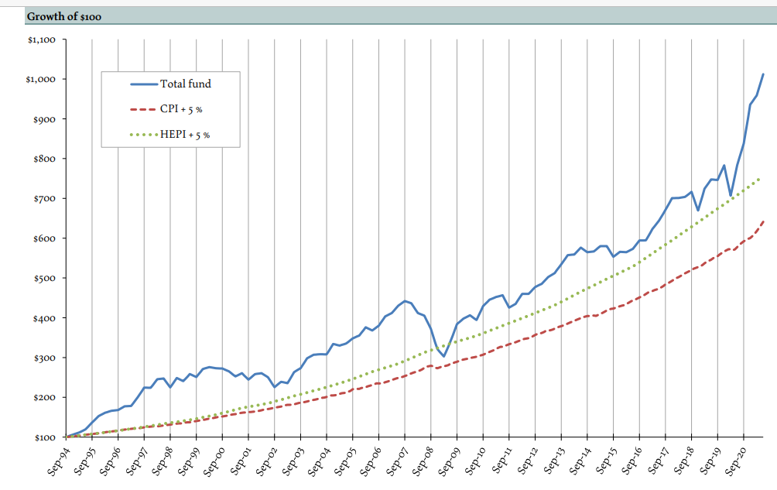
Courtesy of DHK Financial Advisors

Slide 23
Initiatives
Campus Wide Energy Assessment Report & Proposed Energy Master Plan complete in October and presented to campus for discussion.
Climate Action Planning Committee being created, 3 students, 3 faculty 3 staff.
As of April 2021, 100% of our electricity is purchased from Northern Power and Light. www.npandl.com
New Composting Company: 100% of our food waste is now being composted by Blue Line Compost. https://bluelinecompost.com
Anticipating maintaining STARS Bronze Certification for the 3rd year
Sustainability Grant Deadline for Fall 2021 is Sep 17th at 12pm, Campus-wide Vote Sep 27th-Oct 1st
2 Sustainability Fellow Positions funded by Casella (now open to graduate students)
Fall programing calendar is available on the website. www.paulsmiths.edu/sustainability
Interpretative Signs will be posted around campus by November.

Slide 24
Enrollment
Robert Herr, Vice President for Enrollment has asked Hannah Ackermann to present current data.

Slide 26
Who They Are
Largest incoming class since 2016
257 First Year students
49 Transfer students
10 Graduate students
30 States and 2 countries represented
60% from NY, 40% out of state
Top 5 states: NY, CT, PA, VT, MA
(as of 8/18)
Top 5 intended majors:
Fisheries and Wildlife Management
Natural Resource & Conservation Management
Management
Environmental Science
Forestry
90+ Student Athletes
64% male / 34% female / 2% other
Thanks to everyone for helping enroll this class!

Slide 27
Research
Daniel Kelting

Slide 28
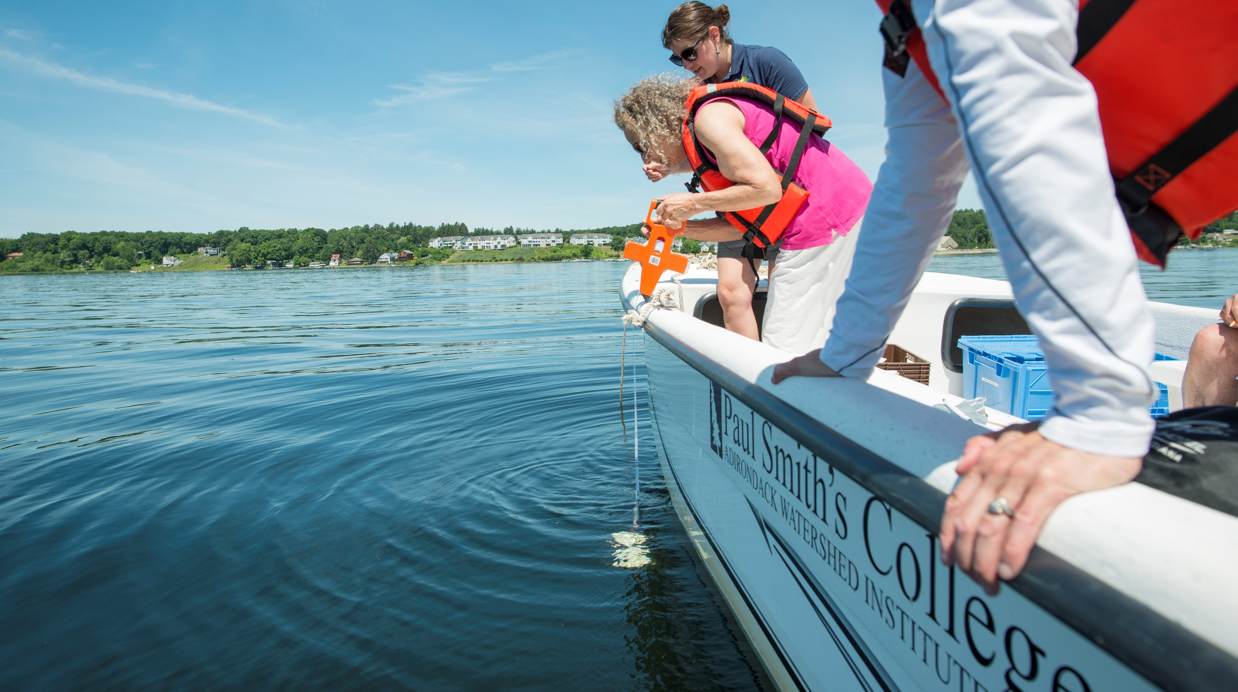
Paul Smith’s College Adirondack Watershed Institute
Protect Clean Water & Promote Healthy Watersheds
Science
$3 million annual budget
Stewardship
13 full-time & 120 seasonal staff
Community
Staff 56 launches & 29 decon stations
Monitor 90 lakes & 15 streams
Inform policy & legislation: e.g. invasive species & road salt bills

Slide 29
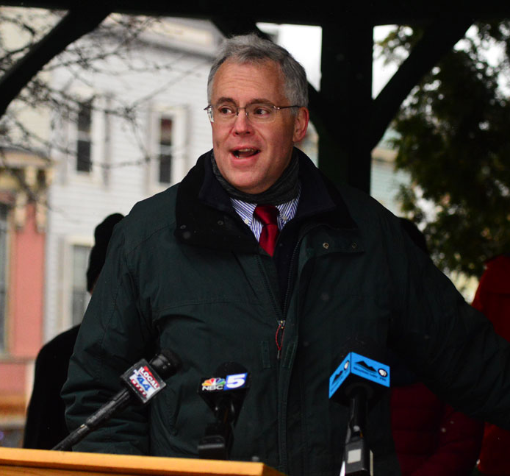
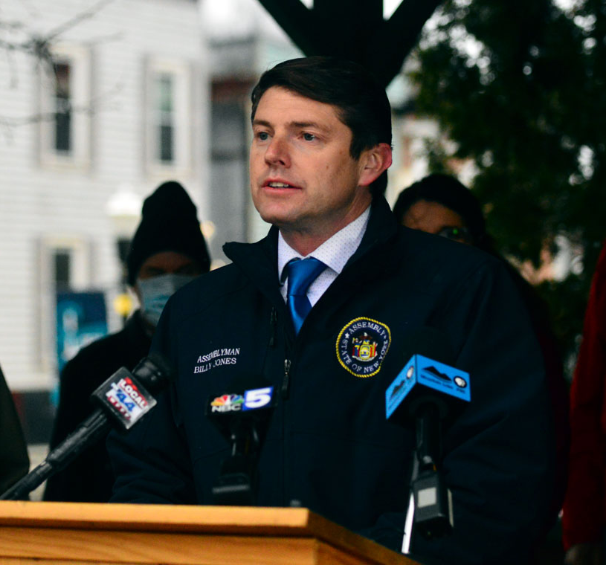
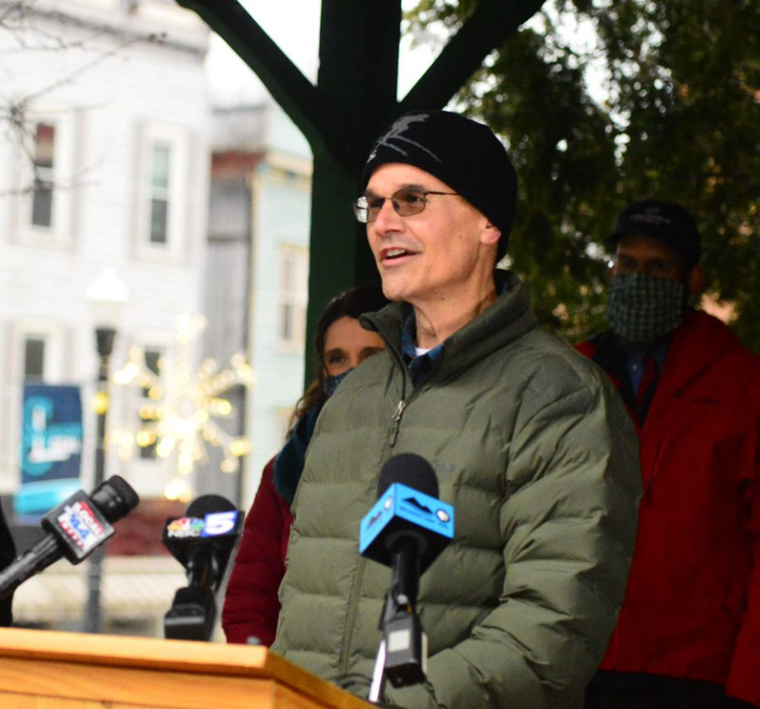
VP of Research – Roles & Responsibilities
Continue to build strong relationships with government officials
B. Jones, D. Stec, T. Kaminsky, T. Kennedy, E. Stefanik
Identify and pursue government funding for college initiatives
$1 million earmark submitted by both Gillibrand & Schumer
Support faculty and staff in obtaining funding for their work
$450K distance learning/technology grant by Cali Shelton

Slide 30
Adirondack Water Week
Valuing Our Precious Waterways
August 22nd to 28th, 2021
Fun Family Activities ● Guided Paddles● Lectures Wool & Water ● River Clean-Up ● & More
Adirondack Park
Invasive Plant Program
www.adkwatershed.org/stewardship/water-week

Slide 31
Student Affairs
Courtney Bringley

Slide 32
Updated Organization Chart
Dean of Students
Courtney Bringley
Center for Academic & Career Success
Student Affairs
Academic & Career Support Staff:
Jessica Appleby
Maureen Pellerin
Melinda Bard
Tracy Elliott
Lydia Wright
Accommodative Services Staff:
Vanessa Case
HEOP Staff:
Katherine Mullen (Director)
Robert Visicaro
TRIO Staff:
Amanda Vincent (Director)
Lydia Wright
Monica Buriello
Paula McClure
CARE Team Staff:
Nicola Smith
Student Counseling Staff:
Najla Hrustanovic (Director)
Amy Bellair
Holly Clement
Health Services Staff:
Christine Brennan (Director)
Annabella Abbadessa
Athletics & Rec. Staff:
Jim Tucker (Director)
Zach Luzzi
Matthew Doughtery
Casey Gerrish
Bailey Waterbury
Joshua Clemens
Student Life Staff:
Lou Kaminski (Director)
Rikelmy Williams
Jill Susice
Donna Good

Slide 33
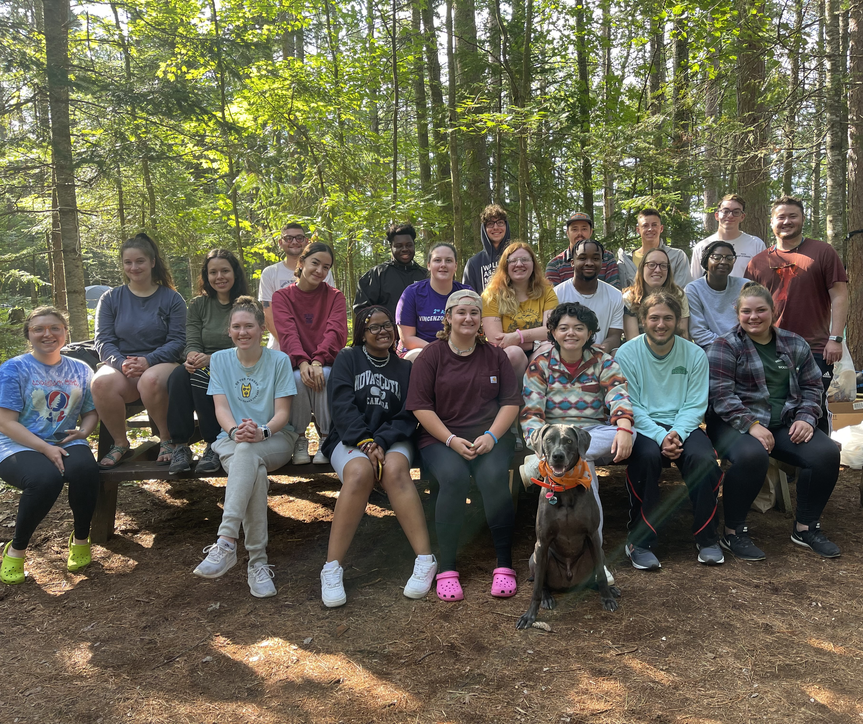
Student Arrival & Welcome Weekend
Hosted Zoom webinar for students on 8/10
Student leaders and athletes are already on campus
New students arriving tomorrow
Returning students arriving Sunday and Monday
Welcome Weekend – Friday through Monday
Full schedule emailed earlier this week
Advisor Meetings Monday 8/23 from 9:00-11:30 **some exceptions!
Convocation Monday 8/23 – line-up begins at 1:00 with program start at 1:30

Slide 34
Student Success & Retention
Data and reporting will be a top priority for all CACS and Student Affairs departments
Student Life team to track all campus sponsored events and activities
Opportunities for collaboration through themed programming weeks
Reshaping and aligning to ensure a cohesive approach to student success and retention

Slide 35
Important Updates/Reminders for Academic Success
CACS will work in collaboration with Health Services to report students that are placed on attendance restrictions
Accommodations should be provided to students placed on quarantine or isolation
Student bereavement & compassionate withdrawal policies in the works, will go to CSC this semester
Starfish Early Alert Survey – will open 9/15 and close on 9/20
Last day to drop without notation on transcript 9/21
Midterm Grades due 10/14
Last day to drop with notation on transcript 10/20
Partnership between Student Support & Faculty is key to student success!

Slide 36
COVID Task Force Updates
Task Force continues to meet weekly on Thursdays
COVID-19 page is being maintained
Continue to follow and align our protocols with NYS & CDC guidance
All students must submit proof of vaccination or negative PCR test
Masking mandate will continue until we know more about vaccination percentage – receiving student documentation daily!
Random cohort testing for all non-vaccinated
No residence hall visitors
Working with AMC to possibly do vaccine clinic(s) on campus
Will monitor NYS/CDC/CICU guidance, local county transmission rates, data from random cohort sampling, along with percent of population vaccinated and adjust as needed
Change will be constant - Communication will remain a priority!
Questions – covidcoordinator@paulsmiths.edu

Slide 37
Q & A Please drop your question into the chat option on Zoom!

