Slide 1
Canvas Best Practices

Slide 2
Students start with
visual representation of course
a brief description or introduction
clear instructions
quick and easy navigation to current content
UDL 2.5 Illustrate through multiple media.
PSC recommends a welcome announcement with this information.
Notes:
Front page not recommended for entire term. Everything except visual representation can go in Module 0. Visual can go in Syllabus or welcome.

Slide 3
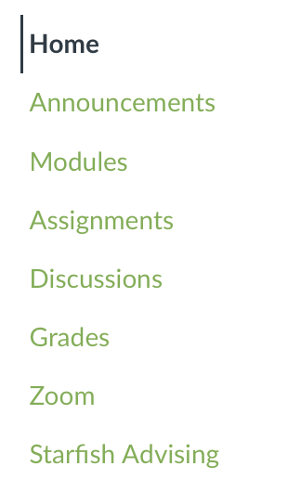
Clear and consistent navigation without unused items
UDL 7.3 Minimize threats and distractions.
Notes:
Front page not recommended for entire term. Everything except visual representation can go in Module 0. Visual can go in Syllabus or welcome.

Slide 4
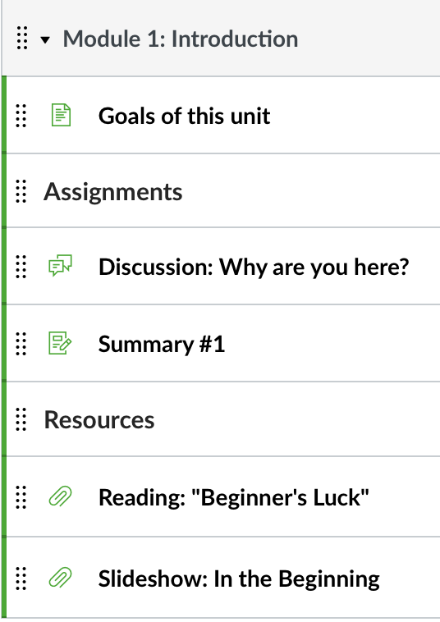
Key learning information
goals
learning objectives
course materials
readings and resources
UDL 8.1 Heighten salience of goals and objectives.
Notes:
Front page not recommended for entire term. Everything except visual representation can go in Module 0. Visual can go in Syllabus or welcome.

Slide 5
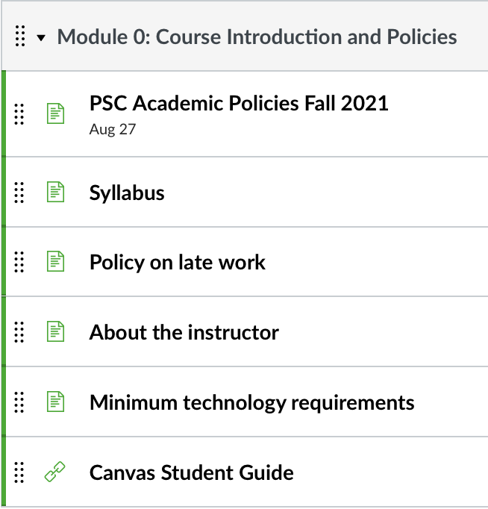
Expectations such as
participation and attendance
etiquette
policies for grading and late work
technology requirements

Slide 6
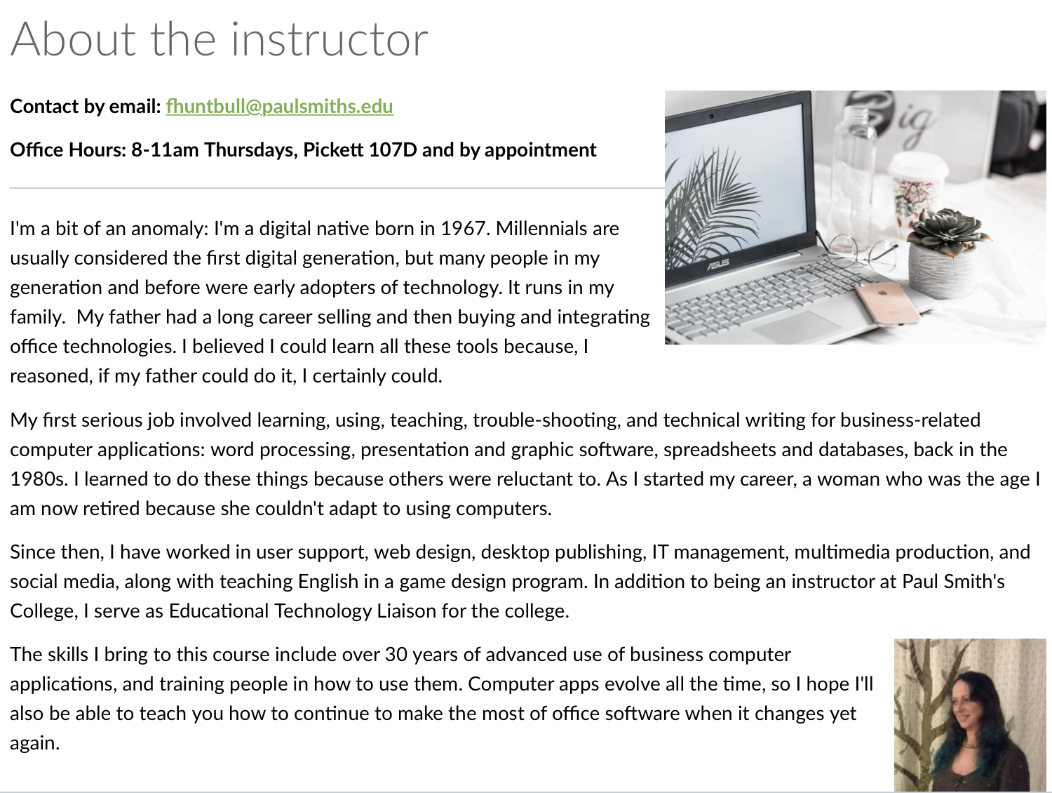
Contact info
contact preference
availability
picture
may include biography
put pronouns in account settings

Slide 7
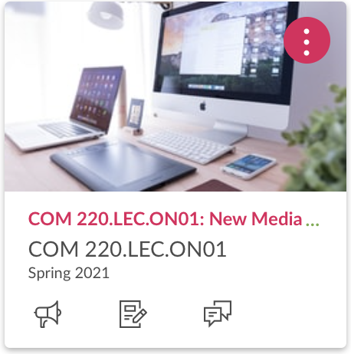
Course card
in Dashboard view
visual representation of the subject
add in Course Settings.
UDL 2.5 Illustrate through multiple media.

Slide 8
Course Content
Follow copyright law.
Check that links, files, videos and external URLs work.
“Chunk” content into manageable pieces in modules.
UDL 3.3 Guide information processing, visualization, and manipulation.

Slide 9
Design for
Student-teacher interaction
Student-student interaction (discussions, collaboration, peer reviews)
Student-content interaction and self-assessment
UDL 8.3 Foster collaboration and community.
UDL 9.3 Develop self-assessment and reflection.

Slide 10
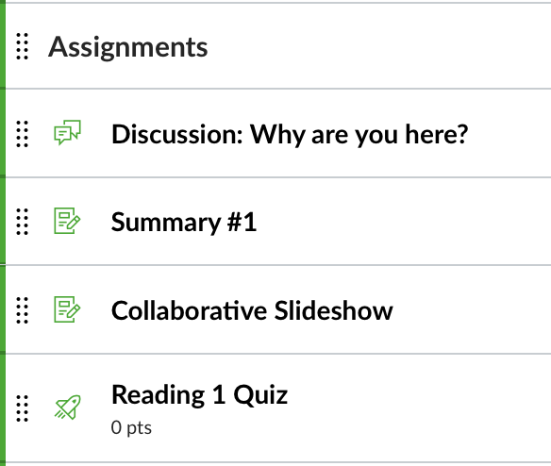
Assessment
Clearly written, detailed instructions ensure understanding to support student actions.
Variety of assessments (discussions, individual and group assignments, quizzes) increase learner engagement and promote active learning.
UDL 4.2 Optimize access to tools and assistive technologies.
UDL 4.1 Vary the methods for response and navigation.

Slide 11
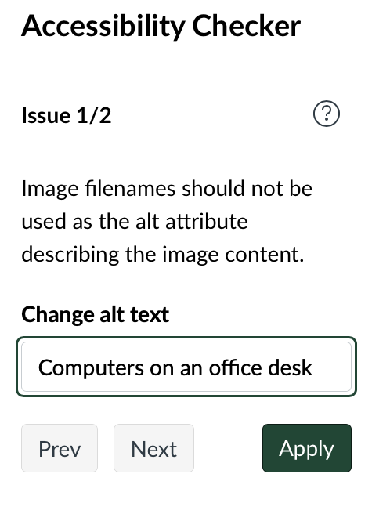
Accessibility
Use tools such as the Accessibility Checker
UDL 7.3 Minimize threats and distractions.

Slide 12
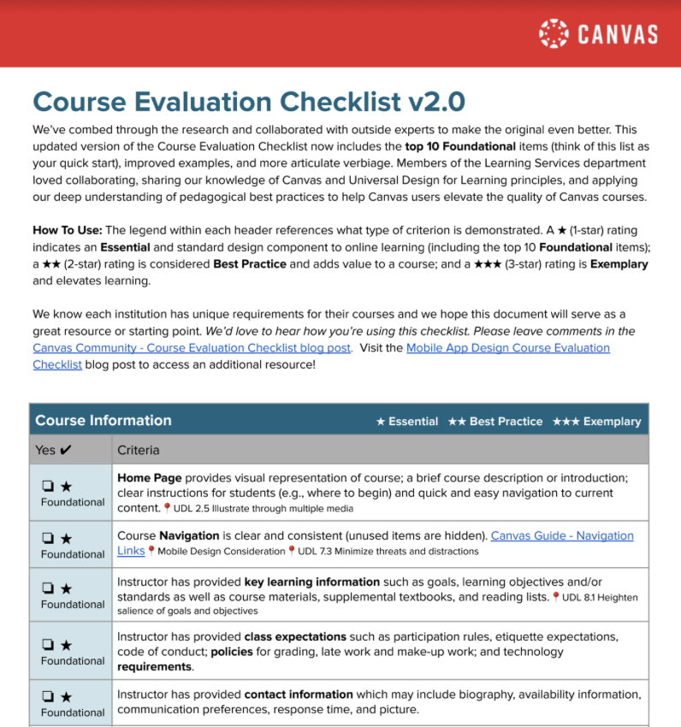
Check out PSC’s Best Practices Guide and Canvas’ Evaluation Checklist for more information.

Slide 13
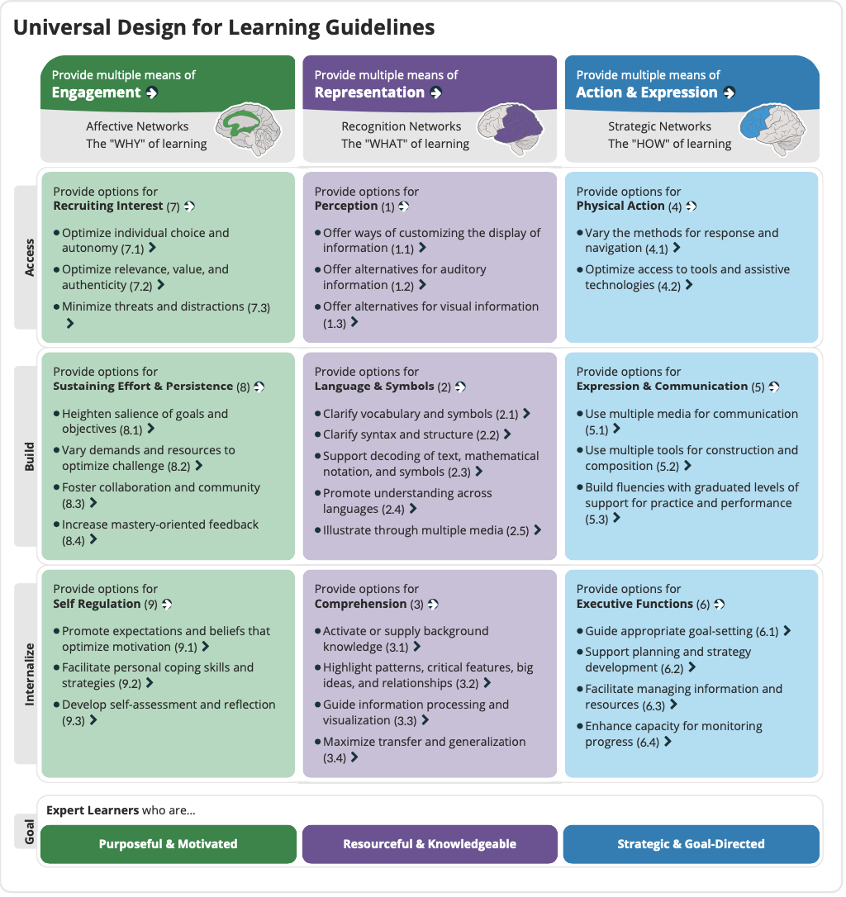
What’s UDL?
Universal Design for Learning is a framework to improve and optimize teaching and learning for all people based on scientific insights into how humans learn.

Slide 14
Required
Use Announcements
Use Modules to organize content in a logical, sequential manner.
Include the current term’s Module 0 with PSC policies.
Post a syllabus.
Post all course material, assignments, and resources in modules.
Post all assignments, with instructions and due dates.
Use assignment group weighting.
Include Zoom in the course navigation settings.
Use the standard order for items in the Navigation bar.

Slide 15
Recommended
Weekly “to do” lists for students using announcements.
Use the discussion board for general questions.
Use an image on your course’s “card”.
Create overview and wrap-up pages for each module.
Use rubrics.
Use modules for the home page.
Set your information in your Canvas Account Profile.
Validate links.

