Slide 1
Provost Day January 2022

Slide 2
Agenda for today
Provost updates, IGE revision (Zoom) 10-11 am
Degree Planner Training (Zoom) 11-12 am
Break, food available in ADK Room (in person) 12-1 pm
Canvas updates (in person or Zoom) 1-2 pm

Slide 3
Calendar for AY 22-23, with late spring start
First day of class fall 2022, August 23, 2022, last class day fall 2022, December 5, 2022
World University Games in LP, January 12-22, 2023
First day of class spring 2023, January 31, 2023 (online only)
First f2f teaching day, Tuesday February 14, 2023
Vacation days for President’s Day 2/20, March Break 3/20-24, and random vacation day Friday 4/21
Last day of class Monday May 15, 2023
Commencement Saturday May 20, 2023

Slide 4
Paylocity update
Employees have been tracking vacations, sick days, etc.
Over the semester it will be rolled out for faculty as well

Slide 5
Degree Planner
Mandate to use this for student program planning, at least by Fall 2022
Training right after this session!
Registrar’s Office will stop routinely distributing the paper plan sheets

Slide 6
Gen Ed Revision

Slide 7
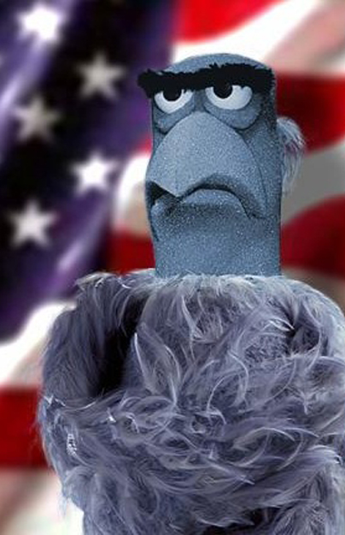
Why is Gen Ed important
Universally recognized as the key element in US college education (unlike UK, Europe or Canada)
Helps create well rounded graduates ready to appreciate life and manage complexity
Shows what the college values, by…
Forcing students to take certain courses they might otherwise avoid
Provides a foundation for majors
Creates work for certain departments

Slide 8
PSC General Education Review
Subcommittee [Andermatt, Aicher, Davidson, Lalonde, Milewski] reviewed current IGE. Considered history of IGE (2005), carried out a survey, etc.
Provided thirty-page report on their results

Slide 9
Survey of Faculty
Organized by faculty ad hoc committee
Likert scale: Strongly Agree, Agree, No Opinion, Disagree, Strongly Disagree
68% participation rate (wow!)

Slide 10
Some key survey results
IGE is user-friendly and easy for faculty to assess: Agree: 20.6%, No Op. 26.5%, Disagree 52.9%
IGE is perceived as relevant by students: Agree 5.8%, No Op 29.4%, Disagree 64.7%
Gen Ed reflects basic skills and competencies that students need: Agree 23.5%, No Op 26.5%, Disagree 50%

Slide 11
Comparison with other colleges
FYS is rare, required writing course is common, capstones are rare (and I noticed that many of the samples included public speaking and two composition courses)
How many courses are standard for Gen Ed?

Slide 12
Size of competitor’s Gen Ed.
30-33 37-40 41-43 44-47

Slide 13
Report Executive Summary
“The basic findings indicate that faculty have a tepid relationship with the IGE program due in part to its complexity, scaffolding of courses some areas of literacy, and assessment challenges. Also, IGE possesses a structure that masks the significant role the social sciences, humanities and natural sciences could play in developing upper division courses for a “signature” GE model that has strong buy-in by faculty and is seen as relevant to our students.” [Review of PSC IGE, pg. 1]

Slide 14
Proposed changes (in my language)
Create a “Gen Ed Coordinator” like other Coordinators, but reporting to CSC
Create a “signature” PSC General Education Program: a mixture of skills (example: composition) and disciplinary/thematic courses
Use FYS to introduce Gen Ed
Address basic areas of knowledge, such as social science, humanities, natural science
“Decouple UD” courses…that is, have far fewer pre-reqs for UD gen ed options

Slide 15
Stalking Horse
Gen Ed with 6 components: 1) Skills + 2) five “Areas of Knowledge” such a “humanities,” “natural sciences,” etc.
“Skills” would include: FYS, Math, Composition I, Information Literacy ☺
Each “area” would require two courses (one LD/100-200 level, one UD/300-500 level)
Consider including diversity/”cultural competency” area of knowledge
Capstone could stay in programs or be moved to Gen Ed

Slide 16
Next Steps
Establish process for faculty decision making, reporting to CSC and Senate/ Congress. CSC should work this out
1
Decide which skills are so central that they should be in the “skills” area. Composition, Math (quantitative reasoning), etc.
2
Debate/decide what areas of knowledge (maximum of five) should be included. For example, we might have Nat Sci or “Environmental literacy” with BIO required
3

Slide 17
Next, Next Step
Figure out how to get from here (IGE from 2005) to new Gen Ed (2024?)
This should be considered as a separate issue from figuring out the ideal/signature general education program for PSC

Slide 18
Almost done…

Slide 19
Stress and exhaustion
Clearly everyone is under a lot of stress right now.
Life is hard, job is hard, limited interactions in person and too many interactions online/zoom/teams/whatever…
Yet we are still managing to teach our courses effectively
Are we all burning out? Chronicle of Higher Education, Dec 15, 2022
NOTE: we are going to discuss handling stress as part of Opening Day tomorrow

Slide 20
Burnout, 2
Chronicle article I mentioned above refers to a classic book on burnout by Berkley Psychologist Christina Maslach.
Maslach argues that “burnout has three dimensions: exhaustion, cynicism, and a sense of ineffectiveness or diminished accomplishment. You’re burned out when you are constantly drained of energy (exhaustion), when you see your students as problems rather than people you’re meant to help (cynicism), and when you feel that your work accomplishes nothing (ineffectiveness).

Slide 21
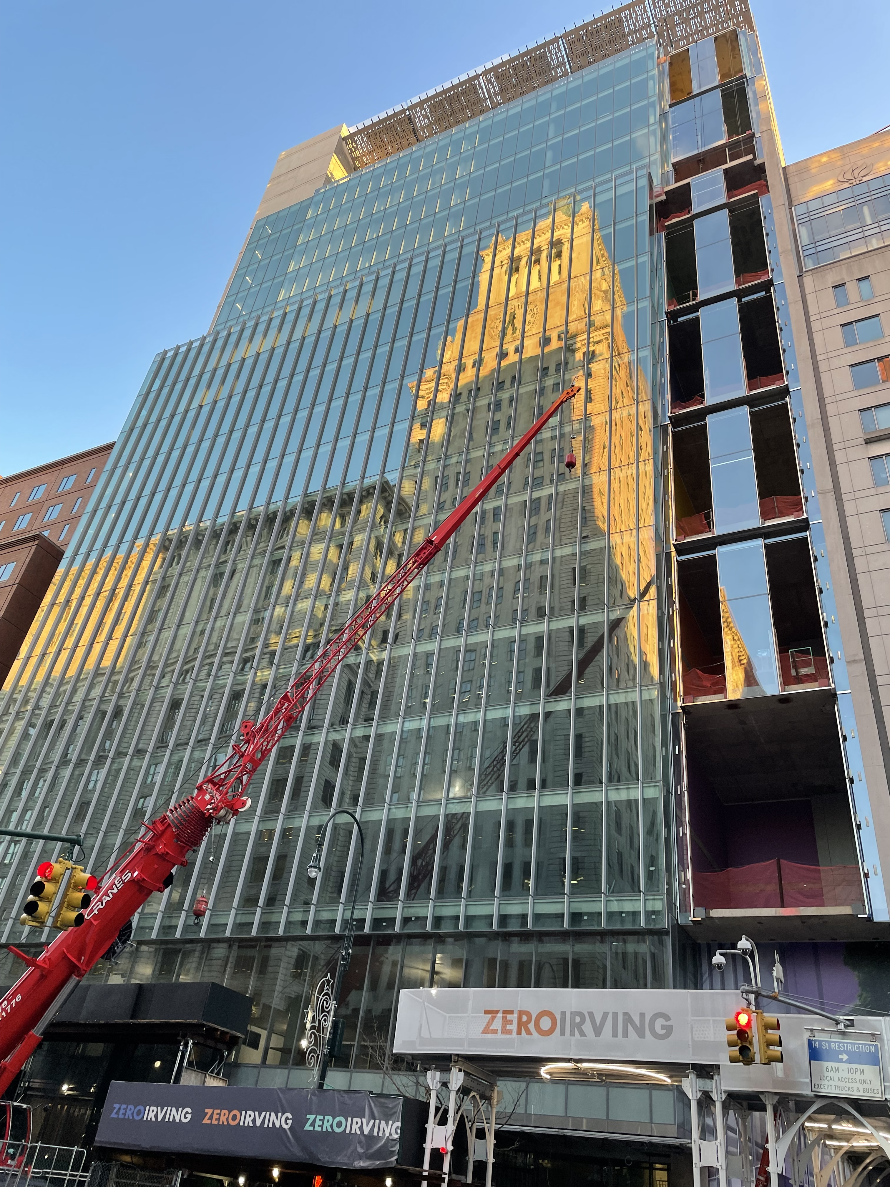
Fedcap
Immediate impact of relationship with Fedcap: nothing
Medium term impact of relationship with Fedcap: lots of conversations, likely leading to some new opportunities, such as doing training in ADKs or having a classroom or two on location in NYC
Long-term impact of relationship with Fedcap: unknown, but almost certainly positive
Fedcap new space in Manhattan

Slide 22
And finally
Questions
Fedcap “brainstorming”…what ideas do people have for projects we should focus on in working with Fedcap? [put idea in chat!]

Slide 23
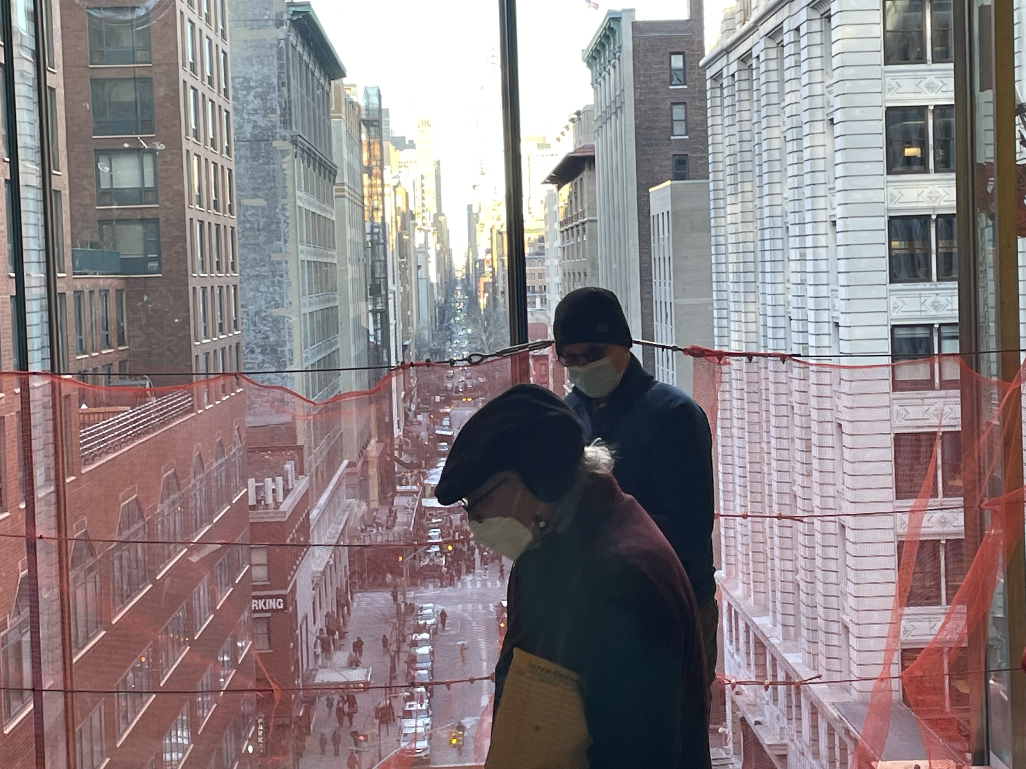
More Fedcap images…

